Slide 1
YAML based Azure Pipelines

Slide 2
Agenda
Getting to know YAML
What’s the problem with classic pipelines
Understanding the what & why for switching to YAML
Why should you migrate ?
Building an YAML pipeline from scratch
Notes:
If you have started using Azure DevOps several years ago (maybe its name was Visual Studio Team Services by then)

Slide 3
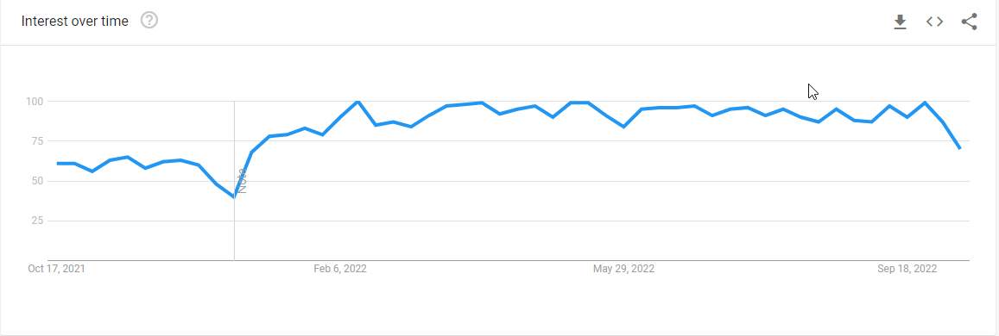
YAML
YAML Ain’t Markup Language
Mostly used for configuration files
Released in 2001

Slide 4
Understanding the problem in (Classic) pipelines
The Classic pipelines in Azure, does not fall under source control
Making changes or experimenting things is hard since it is shared across the project. There are no branching concepts.
Hard to achieve re-usability, we cannot create common shared pipeline logic. We must use Task-Groups, which still involves importing/exporting JSON files.
It is not the default option in Azure DevOps for pipelines anymore. It will be deprecated eventually.

Slide 5
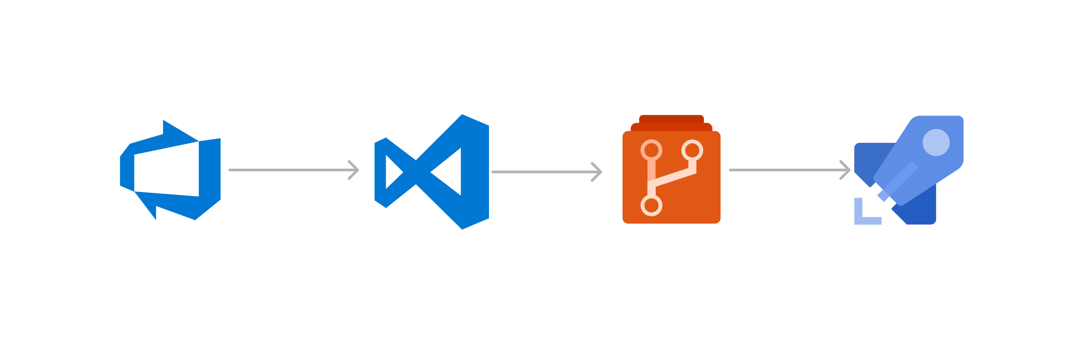
YAML is just like your code
Experiments / changes does not affect feature branches
Reusability with shared templates

Slide 6
Why should you migrate ?
Source controlled , hence achieving - Infrastructure As Code
We can create a re-usable shared YAML components for sharing across the application like standard build template based on project type, (C#, Node)
Easy to experiment or modify things as changes are specific to feature branches & does not affect the whole team.
Most CI/CD tools support YAML, which makes it easier for you to change from one tool to another.
Gitlab / GitHub / Atlassian’s Bitbucket everyone uses YAML based pipelines for CI/CD.
Has all the new exclusive set of features from Azure
Notes:
We all have heard the saying “If it works don’t touch it”
So if your project is being going on in Devops for a long time now, you must be having a lot of classic pipelines for various projects

Slide 7
More Advantages on switching to YAML
Leveraging Environments in Azure Devops with Approvals
You can use `if…else` statements to run stages conditionally
You can build projects conditionally / selectively
Ex: If you have Pluto.csproj / Earth.csproj, you can build only earth if only files of earth are changed
Parallel jobs which are running independent of each other
Notes:
This cannot be done in classic pipelines, you cannot use the Environments feature in Devops without using YAML base pipelines.

Slide 8
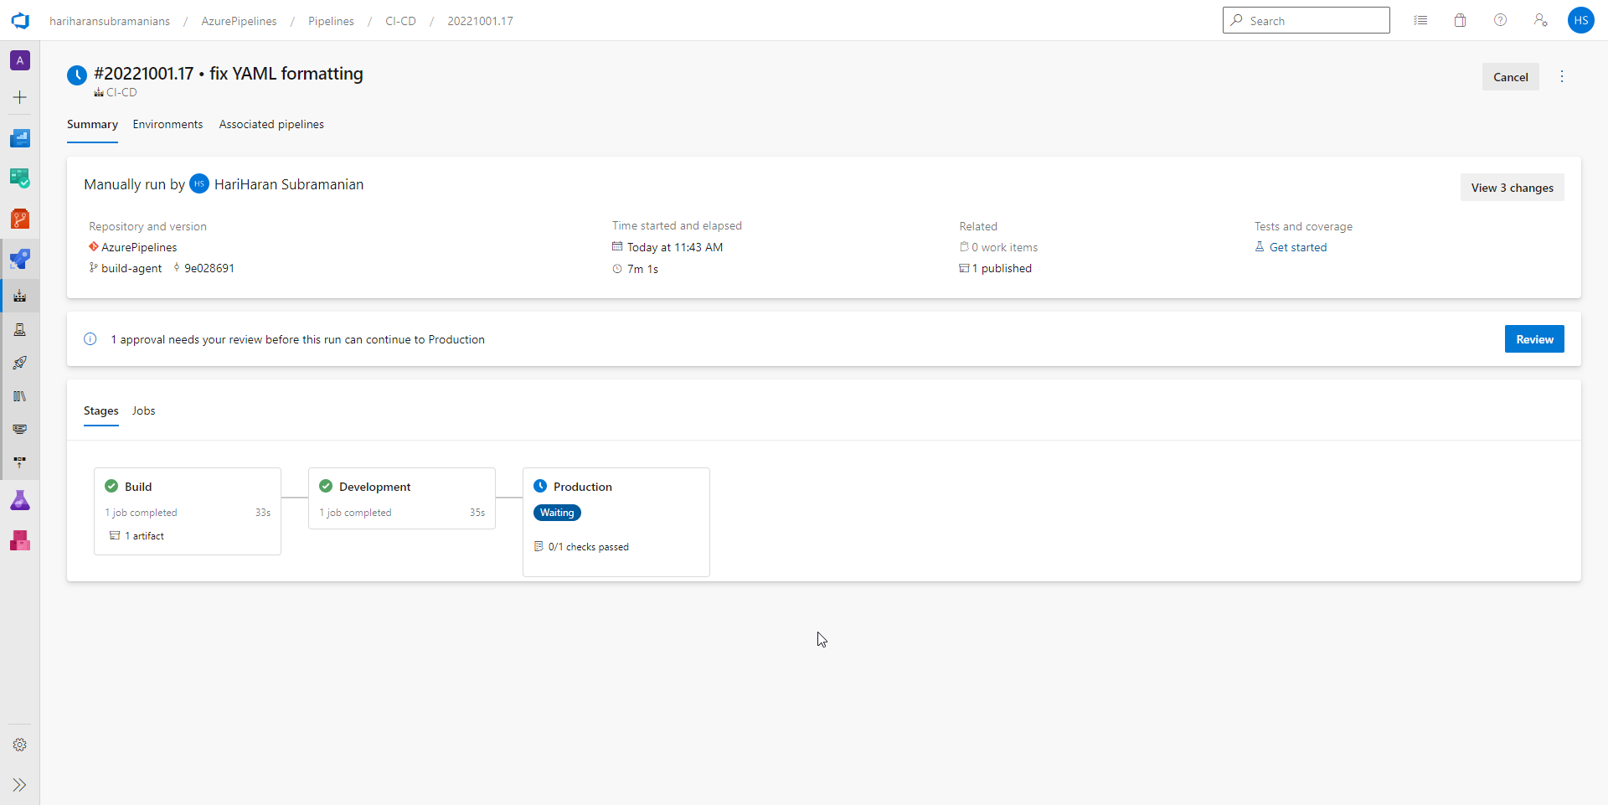

Slide 9
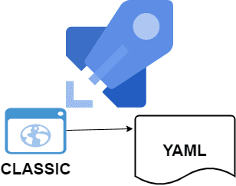
How hard is the migration
Azure provides an assistant to build the YAML stages
You can also create the pipeline from VS Code using Azure Pipelines plugin.
You can get the YAML code right away from your existing classic pipeline by exporting it.

Slide 10
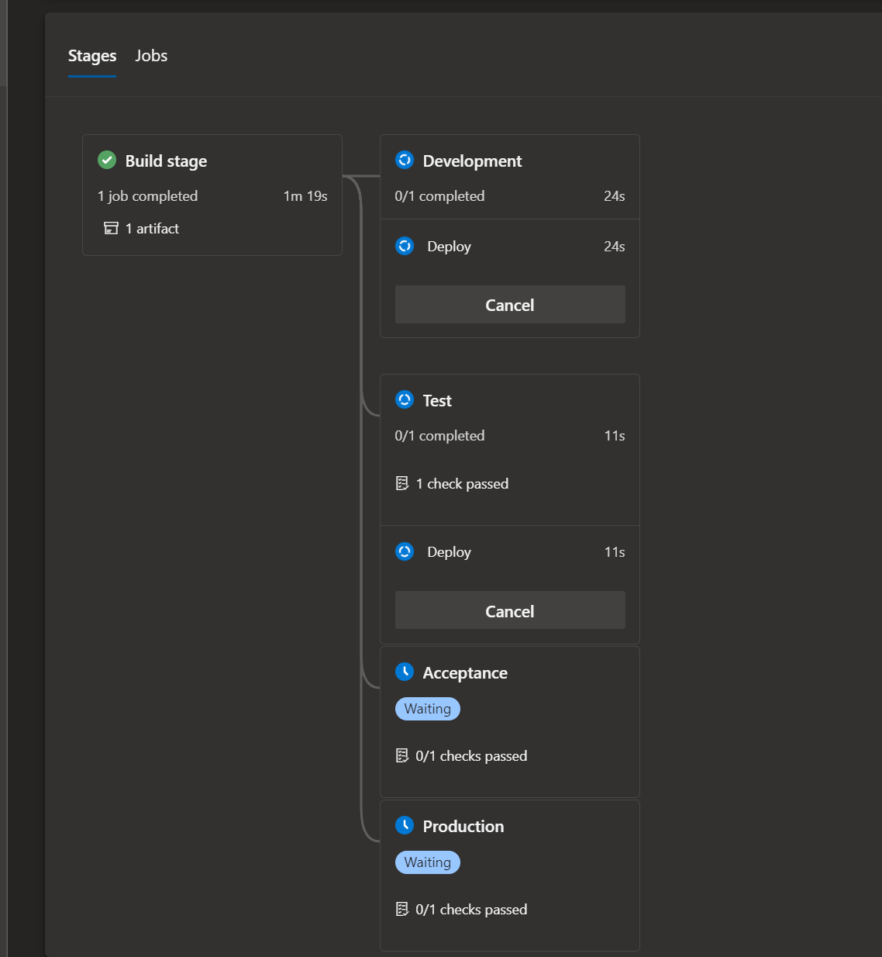
Real world pipeline

Slide 11
DEMO

Slide 12
References
https://devblogs.microsoft.com/devops/replacing-view-yaml/
https://learn.microsoft.com/en-us/azure/devops/pipelines/migrate/from-classic-pipelines?view=azure-devops

Slide 13


HariHaran Subramanian
Senior Software Engineer - Kovai.co
@get_hariharan

